Slide 1
E-Commerce and Technologies
E-Commerce infrastructure:
Internet and WWW

Slide 2
Objectives
Discuss the origins of the Internet.
Identify the key technology concepts behind the Internet.
Describe the role of Internet protocols and utility programs.
Explain the current structure of the Internet.
Explain the limitations of today’s Internet.
Describe the potential capabilities of Internet II.
Explain how the World Wide Web works.
Describe how Internet and Web features and services support e-commerce.

Slide 3
The Internet: Technology Background
Internet
Interconnected network of thousands of networks and millions of computers
Links businesses, educational institutions, government agencies, and individuals
World Wide Web (Web)
One of the Internet’s most popular services
Provides access to around billions, possibly trillions, of Web pages

Slide 4
The Evolution of the Internet 1961—The Present
Innovation
1961-1974
Institutionalization
1975-1994
Commercialization
1995 - →
SOURCE: e-Commerce 2010, Page 3-5, Figure 3.1

Slide 5
The Evolution of the Internet Innovation Phase, 1964–1974
Innovation Phase, 1964–1974
Creation of fundamental building blocks
The concept of packet switching is born
The first “killer” application of the Internet is born ➔ E-mail
Client/server computing is invented
TCP/IP invented

Slide 6
The Evolution of the Internet Institutionalization Phase, 1975–1994
Institutionalization Phase, 1975–1994
Large institutions provide funding and legitimization
TCP/IP is officially adopted as a standard communications protocol
Personal computers are invented
Domain Name System (DNS) is introduced
The concept of Internet-supported service called the World Wide Web based on Hyper Text Markup Language (HTML) pages is born
The first graphical Web browser Mosaic is invented
The first commercial Web browser – Netscape becomes available
The first banner advertisements appear on Hotwired.com in 1994 ➔ The beginnning of e-Commerce

Slide 7
The Evolution of the Internet Commercialization Phase,1995–present
Commercialization Phase,1995–present
Private corporations take over, expand Internet backbone and local service
The fully commercial civilian Internet is born
E-commerce begins with pure online retail stores and auctions in 1995(Amazon, eBay)
The first full service Internet-only bank, FirstInternet Bank of Indiana, opens for business ,in 1999.
Internet “cloud computing” becomes a billion dollar industry in 2008
Internet-enabled smartphoned become a major new Web access platform since 2009

Slide 8
Key Technology Concepts: The Internet
Defined by Federal Networking Commission as network that (1995):
Uses IP addressing
Supports TCP/IP
Provides services to users, in manner similar to telephone system
Three important concepts related iwth Internet are:
Packet switching
TCP/IP communications protocol
Client/server computing

Slide 9
Packet Switching
Slices digital messages into packets
Reassembles packets once they arrive at destination
Uses routers
Special purpose computers that interconnect the computer networks that make up the Internet and route packets
Routing algorithms ensure packets take the best available path toward their destination

Slide 10
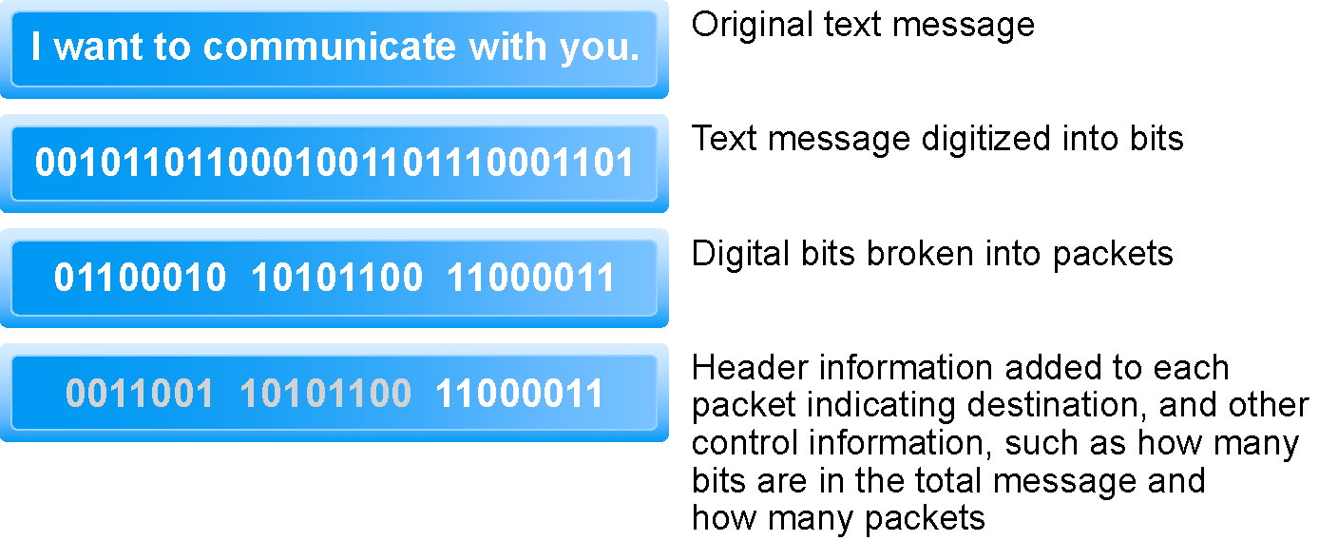
Packet Switching
SOURCE: e-Commerce 2010, Page 3-10, Figure 3.3

Slide 11
TCP/IP
Transmission Control Protocol/Internet Protocol ➔ TCP/IP
The core communications protocol for the Internet
protocol: a set of rules and standards for data transfer

Slide 12
TCP/IP
Transmission Control Protocol (TCP):
Establishes connections between sending and receiving Web computers
Handles assembly of packets at point of transmission, and reassembly at receiving end
Internet Protocol (IP):
Provides the Internet’s addressing scheme
Responsible for the actual delivery of the packets
Four TCP/IP Layers
Network Interface Layer
Internet Layer
Transport Layer
Application Layer

Slide 13
Internet (IP) Addresses
IPv4 addresses:
32-bit number
Expressed as series of four sets of separate numbers marked off by periods
eg. 201.61.186.227
New version: IPv6
128-bit number,
Able to handle up to 1 quadrillion addresses (IPv4 can only handle 4 billion)

Slide 14
Domain Names, DNS, and URLs
Domain Name
IP address expressed in natural language
Domain Name System (DNS)
System for expressing numeric IP addresses in natural language
Uniform Resource Locator (URL)
Address used by Web browser to identify location of content on the Web
Eg. http://

Slide 15
Names and Addresses on Internet
IP addresses | Every device connected to the Internet must have a unique address number called and IP address
Domain Names | The Domain Name System allows expressions such as www.kocaeli.edu.tr (University’s web site) to stand for numeric IP locations
DNS servers | DNS servers are databases that keep track of IP addresses and domain names on the Internet
Root servers | Root servers are central directories that list all domain names currently in use for specific domain; for example, the .com root server
SOURCE: e-Commerce 2010, Page 3-14, Table 3.2

Slide 16
Client/Server Computing
Powerful personal computers (clients) connected in network with one or more servers
Servers perform common functions for the clients
Storing files, software applications, etc.
In the client/server model of computing, client computers are connected in a network together with one or more servers

Slide 17
The New Client: The Emerging Mobile Platform
Within a few years, primary Internet access will be through:
Netbooks
Designed to connect to wireless Internet
Under 2 lbs, solid state memory, 8” displays
$200–400
Smartphones
Disruptive technology: Processors, operating systems
The emerging mobile platform has profound implications for e-commerce because it influences how, where, and when consumers shop and buy

Slide 18
Cloud Computing
The growing bandwidth power of Internet has pushed the client/server model one step further, towards what is called “cloud computing model”
Firms and individuals obtain computing power and software over Internet
E.g., Google Apps
Fastest growing form of computing
Radically reduces costs of:
Building and operating Web sites
Infrastructure, IT support
Hardware, software

Slide 19
Other Internet Protocols and Utility Programs
Internet protocols
HTTP
E-mail: SMTP, POP3, IMAP
FTP, Telnet, SSL
Utility programs
Ping
Tracert
Pathping

Slide 20
Who Governs the Internet?
Organizations that influence Internet and monitor its operations include:
Internet Architecture Board (IAB)
Internet Corporation for Assigned Names and Numbers (ICANN)
Internet Engineering Steering Group (IESG)
Internet Engineering Task Force (IETF)
Internet Society (ISOC)
World Wide Web Consortium (W3C)
International Telecommunications Union (ITU)

Slide 21
Telephone-based Wireless Internet Access
Competing 3G standards
GSM: Used primarily in Europe
CDMA: Used primarily in the United States
Evolution:
2G cellular networks: relatively slow, circuit-switched
2.5G cellular networks: interim networks
3G cellular networks: next generation, packet-switched
3.5G (3G+)
4G (WiMax, LTE)

Slide 22
Wireless Local Area Networks (WLANs)
Wi-Fi
High-speed, fixed broadband wireless LAN, different versions for home and business market, limited range
WiMax
High-speed, medium range broadband wireless metropolitan area network
Bluetooth
Low-speed, short range connection
Ultra-Wideband (UWB)
Low power, short-range high bandwidth network
Zigbee
Short-range, low-power wireless network technology for remotely controlling digital devices

Slide 23
World Wide Web – WWW
Development of the Web
1989–1991: Web invented
Tim Berners-Lee at CERN
HTML, HTTP, Web server, Web browser
1993: Mosaic Web browser w/GUI
Andreesen and others at NCSA
Runs on Windows, Macintosh, or Unix
1994: Netscape Navigator, first commercial Web browser
Andreessen, Jim Clark
1995: Microsoft Internet Explorer

Slide 24
Hypertext
Text formatted with embedded links
Links connect documents to one another, and to other objects such as sound, video, or animation files
Uses Hypertext Transfer Protocol (HTTP) and URLs to locate resources on the Web

Slide 25
Markup Languages
Generalized Markup Language (GML)—1960s
Standard Generalized Markup Language (SGML)—early GML,1986
Hypertext Markup Language (HTML)
Fixed set of predefined markup “tags” used to format text
Controls look and feel of Web pages
eXtensible Markup Language (XML)
New markup language specification developed by W3C
Designed to describe data and information
Tags used are defined by user

Slide 26
Web Servers and Web Clients
Web server software:
Enables a computer to deliver Web pages to clients on networks that request this service by sending an HTTP request
Apache and Microsoft IIS
Basic capabilities: security services, FTP, search engine, data capture
Web server
Can refer to Web server software or physical server
Specialized servers: database servers, ad servers, etc.
Web client:
Any computing device attached to the Internet that is capable of making HTTP requests and displaying HTML pages

Slide 27
Web Browsers
Primary purpose to display Web pages
Internet Explorer (67%) and Firefox (23%) dominate the market
Other browsers include:
Netscape
Opera
Safari (for Apple)
Google’s Chrome

Slide 28
The Internet and Web: Features
Internet and Web features on which the foundations of e-commerce are built include:
E-mail
Instant messaging
Search engines
Intelligent agents (bots)
Online forums and chat
Streaming media
Cookies

Slide 29
Web 2.0 Features and Services
Blogs
Personal Web page that typically contains a series of chronological entries by its author, and links to related Web pages
Really Simple Syndication (RSS)
Program that allows users to have digital content automatically sent to their computers over the Internet

Slide 30
Web 2.0 Features and Services
Podcasting
Audio presentation stored as an audio file and available for download from Web
Wikis
Allows user to easily add and edit content on Web page
New music and video services
Videocasts
Digital video on demand

Slide 31
Web 2.0 Features and Services
Internet telephony (VOIP)
Uses Voice Over Internet Protocol (VOIP) and Internet’s packet-switched network to transmit voice and other forms of audio communication over the Internet
Internet television (IPTV)
Telepresence and video conferencing

Slide 32
Web 2.0 Features and Services
Online software and Web services
Web apps, widgets, and gadgets
Digital software libraries, distributed storage
M-commerce applications
Beginning to take off

